Slide 1
Notes:
Maybe you’ve heard about a scary thing that Trump is trying to do called Public Charge. But what is it? An immigrant who is likely to rely on public assistance is called a “public charge.” One of the things you have to prove when you are applying for a green card (lawful permanent residence) is that you are not a “public charge.”

Slide 2
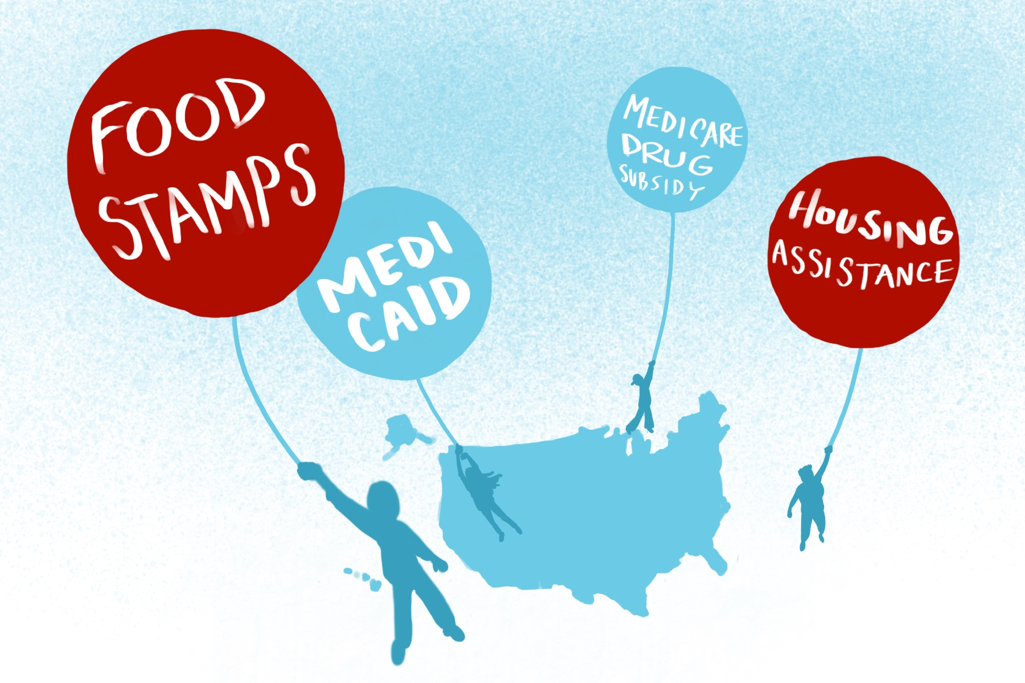
Notes:
Right now, only two public benefits make you a “public charge”: cash assistance (like GA, SSI, TANF) or being institutionalized for a long time at the government’s expense. Under a new rule proposed by Trump’s administration, you could be labeled a public charge for needing food stamps, housing assistance, Medicaid, or the Medicare drug subsidy, or even CHIP (health insurance for kids)! This means if you are an immigrant who needs help in any of these areas, you could be denied a green card, and even deported.

Slide 3
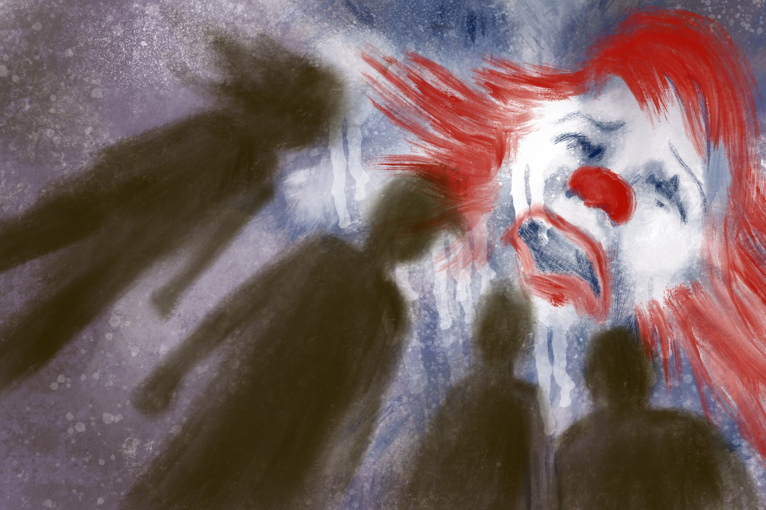
Notes:
This is a terrible plan for immigrant communities. But it’s not the law yet! It can be fought, and everyone can help stop it from becoming the law. Even if you can’t vote yet. Even if you’re not a citizen or a green card holder. You can help, even if you’re not over 18.

Slide 4
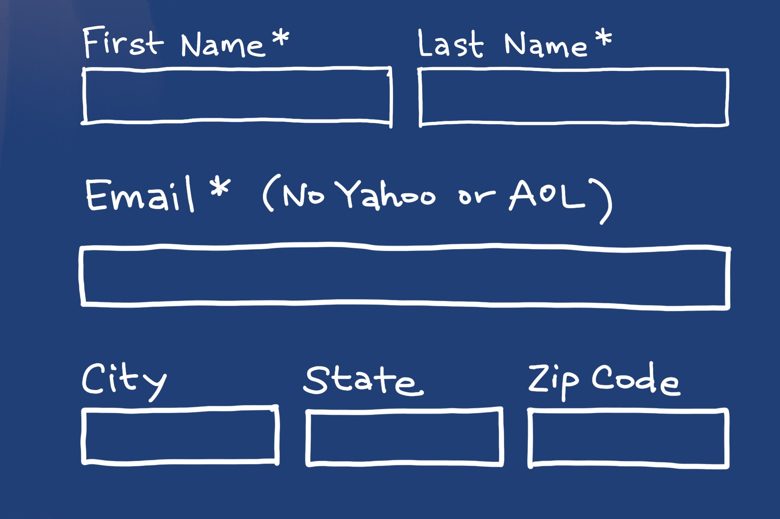
Notes:
The government is taking comments from the public about this proposed rule change from now till December 10th. They have to respond to every single comment, so we are aiming to submit 100,000 comments. Right now, please go to this website: bit.ly/public-comment
Type in your first name, last name. Put in your email address. Add your city, state, and zip code.

Slide 5
Notes:
Now write a short message opposing this change to the public charge rule. You can write a personal story about someone in your family or someone you know who is an immigrant and has needed public assistance. You can write about how we should treat immigrants as people and not separate families or punish people when they need help. You can just write your opinion in simple words. Delete the sample letter in the box and write your own message there.
And that’s it! Thank you for standing together to protect immigrants’ human rights.

